Slide 1

Introduction to Analytics (ALY6000)
Instructor: Dr. Dee Chiluiza, PhD
Week 6

Slide 2
General recommendation:
Review your reports very well before you submit them. Imagine submitting a report to your company with grammatical errors or misspelling the name of the CEO?

Slide 3
Let’s start with your power point presentations.
I’ll create random break rooms of three students.
This time, you must take a minimum of 4 minutes for your presentation and 2 minutes for Q&A.
Do not start the second or third presentations until I indicate it.
Present all relevant information about the role you choose, statistics and implications in the industry.

Slide 4

What is big data?

Slide 5

What is big data?
Large volume of data
Extremely large data sets.
Must be analyzed computationally.
Main purpose is to reveal/discover patterns, trends, and associations.
The data is important, but most important is what the institutions do with that data.
Grow everyday
Can be overwhelming
Facts-based decisions
Strategic business moves
Also defined by Volume, Velocity, Variety

Slide 6
Volume:
Data collected from multiple sources: business transactions, smart (IoT) devices, industrial equipment, videos, social media and more. Now, think about storing issues.
Velocity:
Large volume of data can produce transfer issues. Now data streams at an unprecedented speed and must be handled in a timely manner.
Variety:
Data comes in all types of formats. Structured: numeric data in traditional databases.
Unstructured: text documents, emails, videos, audios, stock data, financial transactions.
Notes:
Internet of Things (IoT) devices support the expansion of internet connection beyond the usual standard devices like computers, laptops, smartphones etc.
These IoT devices are purely integrated with high definition technology which makes it possible for them to communicate or interact over the internet smoothly and can also be managed and controlled remotely when required.

Slide 7
With the amount of data comes another important aspect:
Veracity
It refers to the quality of data.
With the volume, velocity and variety, it is very difficult to link, match, cleanse and transform data across systems.
Businesses need to connect and correlate relationships, hierarchies and multiple data linkages. Otherwise, their data can quickly spiral out of control.

Slide 8
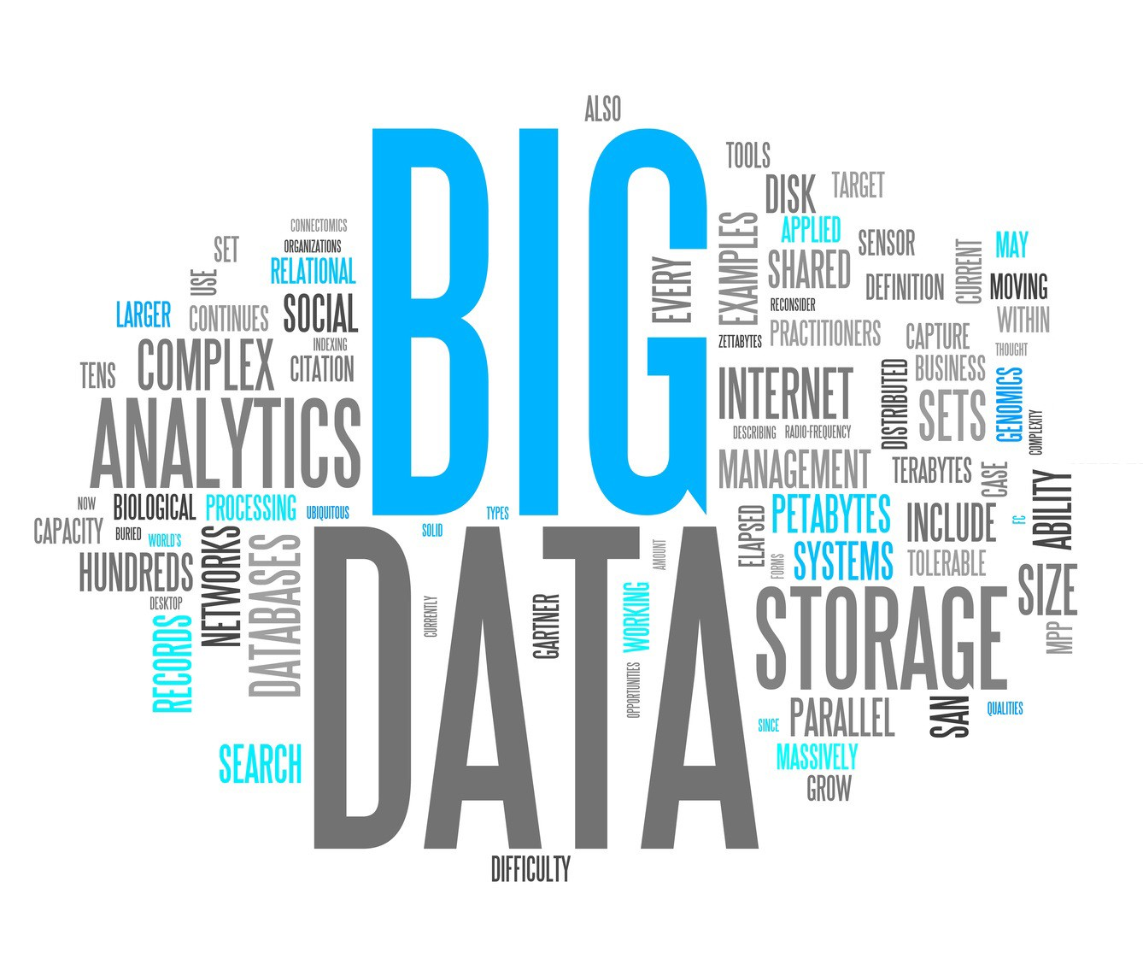
Why Is Big Data Important?

Slide 9
Remember: It is not only about how much data you have, but what you do with it.
You can use it for:
Cost reductions
Time reductions
New product development
Optimize your offer
Smart data-based (facts-based) decision making.
Combining big data with analytics, you can accomplish business-related tasks such as:
Determine root causes of failures, issues and defects in near-real time.
Generate patterns on customer’s buying habits.
Recalculate entire risk portfolios in minutes or seconds.
Detect fraudulent behavior before it affects your organization.
“Data will talk to you if you’re willing to listen”

Slide 10
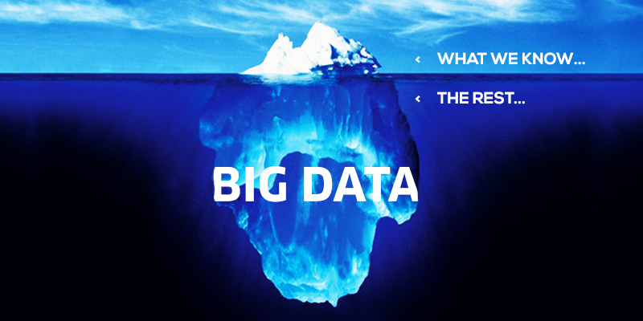

Slide 11
Leveraging Big Data
With proper use of big data, we can:
Understand customers and improve their experience, e.g., airlines, hotels, restaurants.
Improve performance levels, e.g., sport teams, car industry
Create new products based on market demand
Speed the discovery of new therapies, e.g., medical research
Discover novel mutations responsible for diseases, e.g., genomics
Improve people’s safety, e.g., government, police.
Predict vulnerability to fraud among certain customer populations
Notes:
Leveraging=use (something) to maximum advantage

Slide 12
Some steps to follow:
Big data strategy: leader and approach
Recognize the source or sources of data, ensure communication and sharing
Prepare your physical structure to work with big data
Ensure proper ways to store big data: quality and security
Prepare a plan to access and manage big data
Analyze big data, start with a general overview then go deep into the analysis
Summarize your findings and make intelligent data-based (facts-driven) decisions

Slide 13


Imagine you created an application to monitor how many steps a person takes per day.
You want people to get in shape.
With the proper permission of your costumers, you want to collect big data that will allow you to guide your costumers and their nutritionists to make data-based smart decision regarding the progress of their exercise routines.
What is your target population?
What variables would you include?
1.
1.
Remember that big data will be collected live, every second, and it will accumulate really fast.

Slide 14
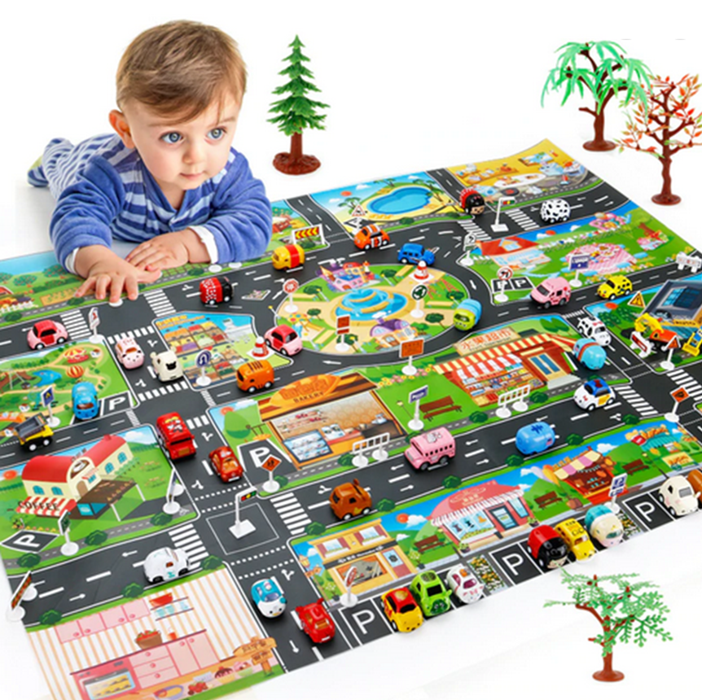
You work for a company that build and sell self-driving taxi cars.
You oversee the activity of these cars during a 3 months test run in San Francisco.
You want to collect big data that will allow your company to make decisions on proper traffic behavior and customer satisfaction.
How do you monitor the cars?
How do you monitor service & satisfaction?
1.
1.
Remember that big data will be collected live, every second, and it will accumulate really fast.

